Slide 1
Sobel with Movement detection
Nous avons pris le projet de base de sobel detection
We’ll See how we optimize all th things with the verilog module and C programming

Slide 2
Optimization Strategy
The main idea was to pipelining two tasks with a DMA
Compute grayscale
Compute sobel
To be able to perform these two tasks in parallel, we designed our algorithm as follows :
Load color pixel for one line
Compute grayscale
Wait 3 lines
Compute sobel
Load news pixel

Slide 3
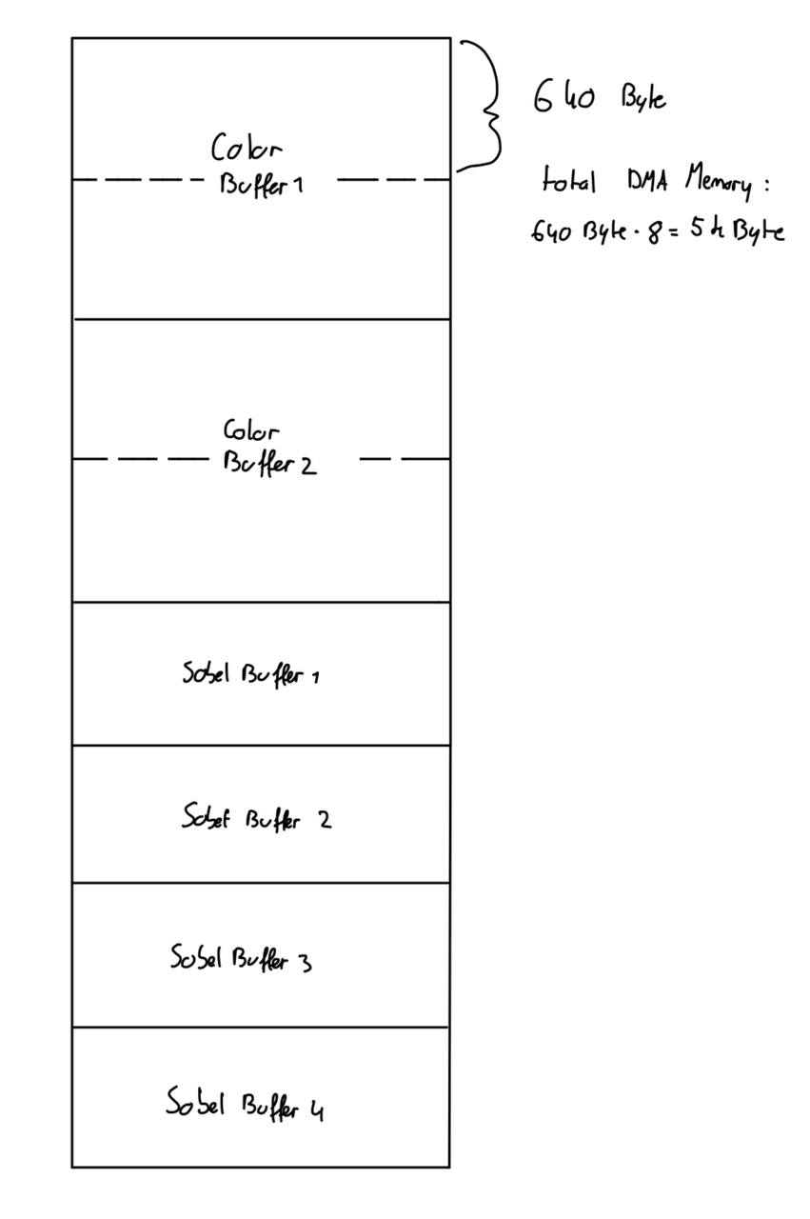
The functions we need to implement
We want to compute one line per pass because it was simpler to handle the edge effects of the Sobel filter (when we're at the border). One grayscale pixel is 8 bits, so 640 Byte for one line. With one line we can transfer 4 pixel with one burst of 32 bits
4 line in memory for sobel (one load and three for computation) 2.5 Kbyte
4 line for RGB pixel (beecause 16 bits for rgb pixel) 2.5 Kbyte
Load one line of sobel pixel
We do a ping-pong buffer with the color pixel and load the result in sobel buffer 1, compute sobel on buffer sobel 2-4 and load in 2. So to implement this we need :
Increase the size of sobel
Sobel verilog
Verilog for manage the pixel index

Slide 4
DMA Enhancements
To facilitate this optimization, we made several enhancements to the DMA:
Address Storage: Added 2 bits for improved address storage capacity.
SSRAM Inputs: Increased the number of SSRAM inputs from 512 to 1280, allowing for more efficient data handling and processing. So that it can fit an entire line of pixels.
Added 2 bits to :
s_ramCiAddressReg
s_memoryStartAddressReg
s_blockSizeReg
s_wordsWrittenReg
s_maxBurstSize
s_usedBurstSize
s_usedBurstSizeReg

Slide 5
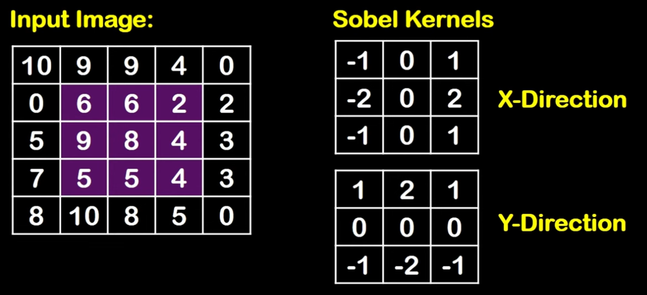
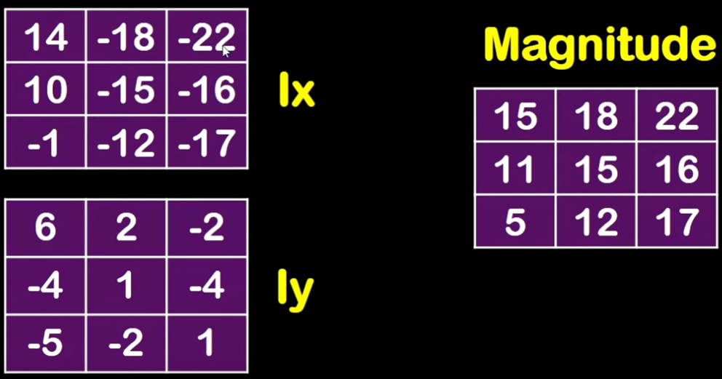
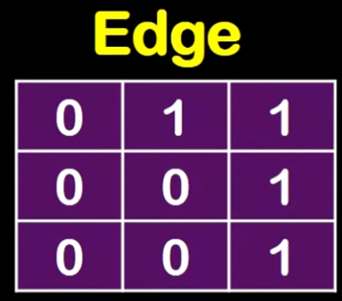
Verilog Implementation
In our implementation, 16 pixels are sent to Verilog for conversion into two 32-bit signals. Each signal contains 4 pixels, which are then used for Sobel calculations.
Verilog ensures seamless integration by managing communication between hardware and software components efficiently.
For edge cases in the image, pixels outside the valid image boundaries are set to 0, maintaining correct Sobel behavior at the image borders.
Magnitude = |Lx| + |Ly|
We calculate the threshold (by doing average value of the magnitude)
The value above the threshold are set to 1 the others to 0

Slide 6
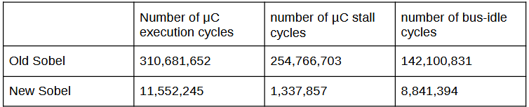
Real-Time Performance
The optimization has resulted in significant improvements in speed and real-time processing capabilities. Key metrics include:
Processing Speed: Achieved a notable reduction in processing time per image.
Real-Time Capability: Enabled the system to handle live image feeds effectively, meeting the project's goals.

Slide 7
DMA-Accelerated Component
The DMA-accelerated component is integral to the project's success. It contributes to optimization by:
Efficient Data Transfer: Minimizing latency in data handling.
Increased Throughput: Allowing for faster processing of pixel data, which is essential for real-time applications.
We also implemented two key optimizations in Verilog:
A grayscale conversion module integrated directly into the data path, removing the need for CPU involvement in grayscale computation.
A mechanism to send blocks of 2×4 pixels directly from the grayscale stage to the Sobel filter, bypassing the CPU entirely.
Although we were not able to get these features fully operational, the implementations are in place and represent an important step toward a more efficient hardware pipeline.

Slide 8
Conclusion and Future Work
In summary, our project successfully optimized Sobel edge detection, achieving faster processing and real-time capabilities.
We also explored further hardware optimizations, whose implementation is present and discussed earlier in the presentation.
Future Work:
Stabilization: Completing and validating the integrated grayscale and direct pixel transfer modules.
Line Rendering Fix: Addressing an issue in the Sobel algorithm where identical values are assigned every 4 pixels, resulting in dull and non-smooth edges.
Further Enhancements: Exploring new architectural improvements for increased efficiency.
Broader Applications: Adapting the system for other real-time image processing tasks and embedded applications.
As a team, we had no prior experience with assembly language before this course. One of us had not coded in over a year and a half, and the other is currently on exchange and discovering this field for the first time. Despite these challenges, we learned a great deal and are proud of the progress we made throughout the project.

